Slide 1
Woodland Public Schools
Facilities and Safety Report
May 2021

Slide 2
Facilities Report
In addition to the scheduled deep cleaning activities in all buildings, the following work and preventive maintenance tasks are scheduled for this summer:
CES | YALE | NFES | WMS | WHS
Paint gym | Drinking water line/filter | Covered play area paint | Roof IT, Commons, Aud. | Tree removal /trim
Replace carpet in room 210 | Remove RR ties in playground | Filter skid | Reader board 4X7 | Horn strobe repair
Music room instrument hooks | Fix swing set (remove cable) | Line paint (pick up lines) | Install bottle fill in the green hall | Bird netting in stadium
Badge reader for cafeteria | Water pump (MECH RM) | Parking lot field | Bathroom stalls (2) | Fix holes in floor
Line paint parking lot | Reader board | Ceiling tiles in hallway | Remove drinking fountains
Filter skid |  | Add 2 bottle fills | Gutters green/yellow hall
Office conversion |  | Ramp to playground | Trim green/yellow hall
Cone of silence |  |  | Remove/replace trees office entrance
Island removal 212/213 |  |  | Add filter to gym water line
Reader board 4X6 |  |  | Separate fire/H2O
Plasma TV install |  |  | Green house steel (wetdeck) install
Replace floor bathroom |  |  | Curb for outside lunch area
Cabinets in health room |  |  | Carpet in rooms 311/318/324
 |  |  | Sidewalk planter

Slide 3
Annual Preventive Maintenance Tasks Summer 2021
Water samples
Bleacher inspections
Asbestos monitoring
Fire and access control battery replacement
Fire Marshall inspection
Annual Septic O&M inspection
AED inspection
Security camera clean/adjust/replace

Slide 4
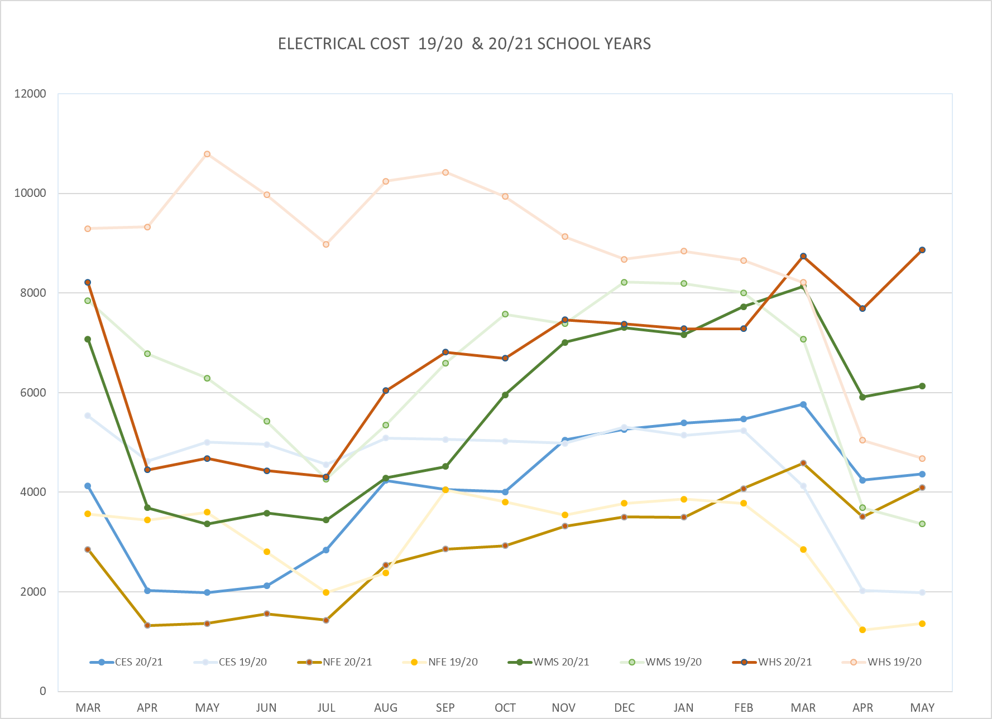
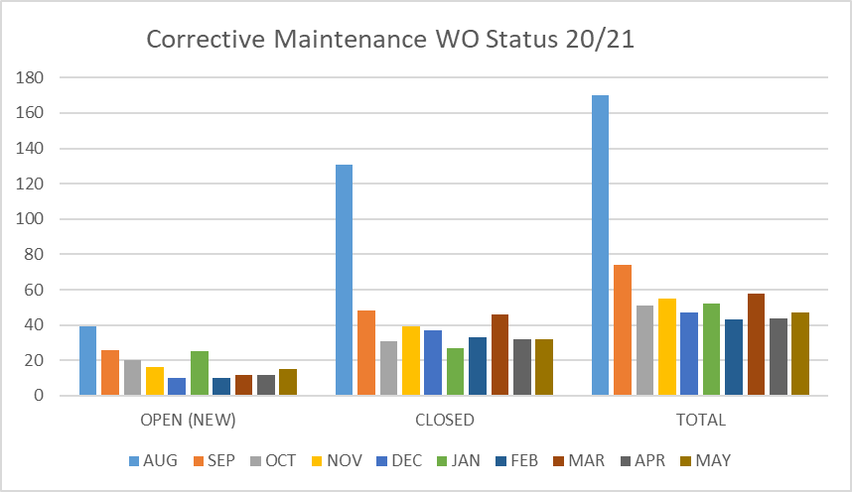
FACILITY CHARTS – POWER COST AND WORK ORDER STATUS

Slide 5
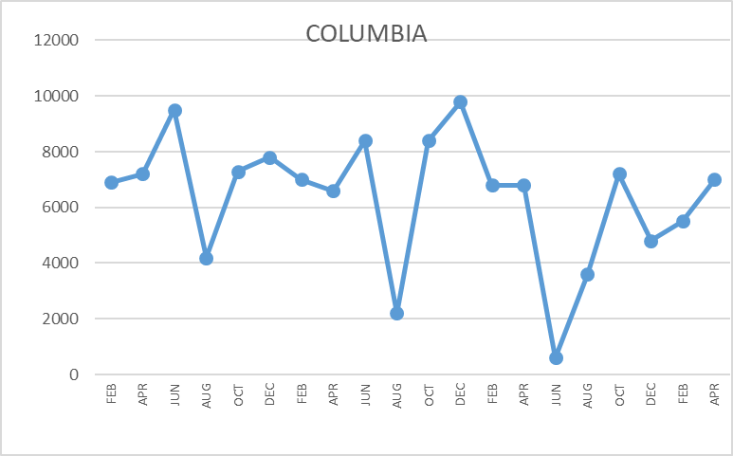
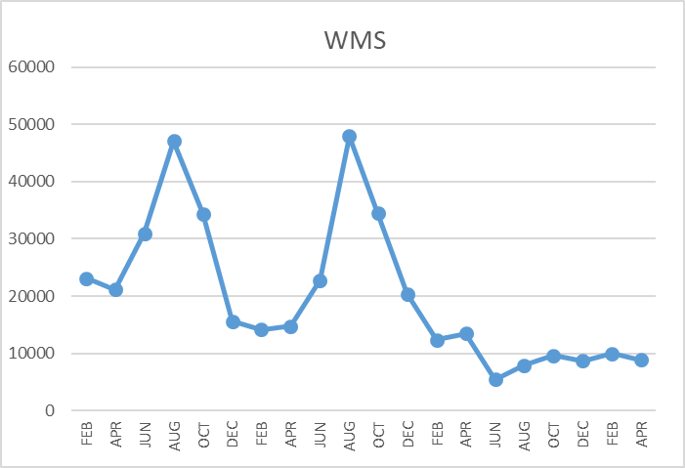
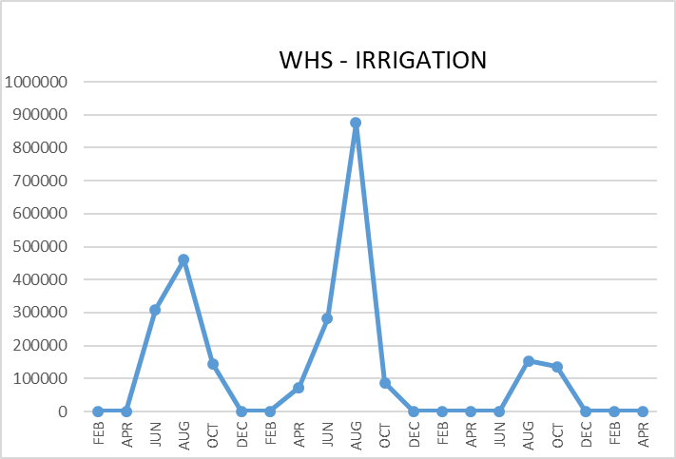
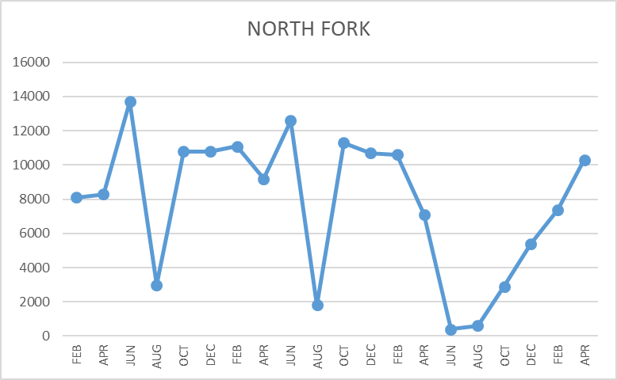
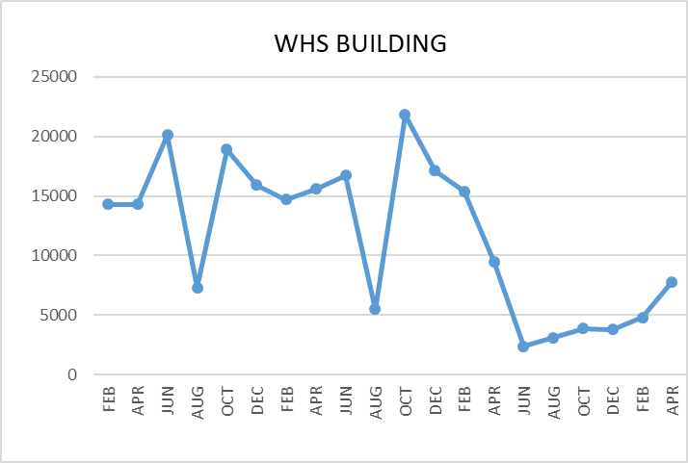
FACILITY CHARTS WATER USAGE WHS, NFES, WMS, CES
Note
Water charts are updated every two
months. Next update to these charts in the June 2021 report
The WMS chart includes the following 7 meters: 755 Park high and low flow, BO and Team High, PIT house, bus barn, athletic field and DO. All of these meters are totaled on the WMS graph, but each data point is recorded separately to aid in identifying leaks.

Slide 6
Safety Summary
Staff Accidents/Incidents
NFES - Employee was kicked in the knee, reported soreness
Student Accidents/Injuries
NFES - Student tripped over own feet while running, fractured right elbow
NFES - Student ran into light pole while looking around for brother, bruised forehead
NFES - Student got finger pinched in door opening, fractured finger
NFES - Student tripped on chair and fell on stomach, sent home due to pain
WMS - Student blocked soccer ball with hand, sprained wrist
WMS - Student hit in head with basketball, concussion

